Slide 1


TensorFlow Ops
Tensor Flow for Deep Learning Research

Slide 2
Feedback is greatly appreciated!

Slide 3

Overview
Word Embeddings (representation of text data)
Frequency based Embedding
Count Vector
TF-IDF Vector
Co-Occurrence Vector
Prediction based Embedding
CBOW (Continuous Bag of words)
Skip Gram

Slide 4
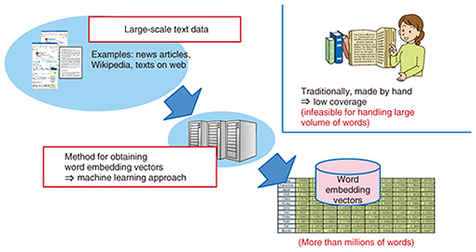
Why Word Embeddings: Essential for text processing with DL
It is an essential part of text processing with Deep Learning
All Deep Learning architectures, are incapable of processing strings or plain text in their raw form
TEXT processing
Source: https://www.analyticsvidhya.com/blog/2017/06/word-embeddings-count-word2veec/
https://www.ntt-review.jp/archive/ntttechnical.php?contents=ntr201711fa4.html

Slide 5
Types of Word Embeddings
Word embeddings can be broadly classified into two categories
Frequency based Embedding
Count Vector
TF-IDF Vector
Co-Occurrence Vector
Prediction based Embedding
word2vec
CBOW (Continuous Bag of words)
Skip-Gram Model
GloVe: Global Vectors for Word Representation
Source: https://www.analyticsvidhya.com/blog/2017/06/word-embeddings-count-word2veec/

Slide 6
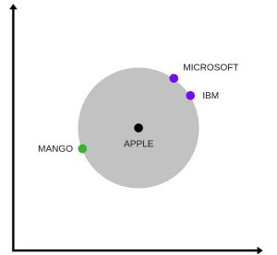
Frequency vs. Prediction Embedding
In FBE, it is a difficult for computers to correctly understand semantic relationships between words
Also, we loose semantic relationship or context between the words
However, with prediction based embeddings we will retain the semantic relationship or context between the words
representation of word vectors in 2 dimension, two contexts of apple have been captured. One is a fruit and the other company
Source: https://www.analyticsvidhya.com/blog/2017/06/word-embeddings-count-word2veec/

Slide 7
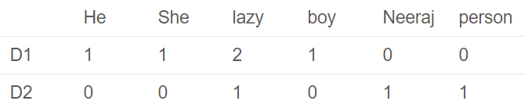
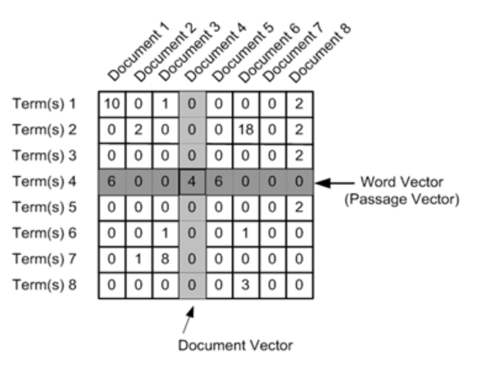
Count Vector
D1: He is a lazy boy. She is also lazy.
D2: Neeraj is a lazy person.

Slide 8
TF-IDF vectorization
This is another method which is based on the frequency method but it is different to the count vectorization in the sense that it takes into account not just the occurrence of a word in a single document but in the entire corpus.

Slide 9
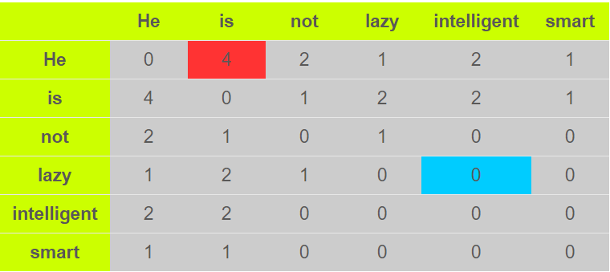
Co-Occurrence Matrix
The big idea-Similar words tend to occur together and will have similar context for example. Apple is a fruit. Mango is a fruit.
Apple and mango tend to have a similar context i.e. fruit.
Quick | Brown | Fox | Jump | Over | The | Lazy | Dog

Slide 10
word2vec
huge splash in NLP world

Slide 11
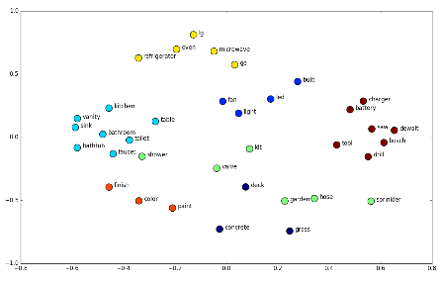
What is word2vec
Word2vec is a two-layer neural network that processes text
Its input is a text corpus and its output is a set of vectors: feature vectors for words in that corpus
The output of the word2vec neural net is a vocabulary in which each item has a vector attached to it, which can be fed into a deep-learning net or simply queried to detect relationships between words
word2vec is a model that uses a vector to represent the word, because calculating word statistics directly is difficult
The purpose and usefulness of word2vec is to group the vectors of similar words together in vector space

Slide 12
Two different architecture for word2vec
CBOW:
The input to the model is the preceding and following words of the current word
The output of the neural network will be wi
Skip-gram:
The input to the model is wi and
The output is the words around it

Slide 13
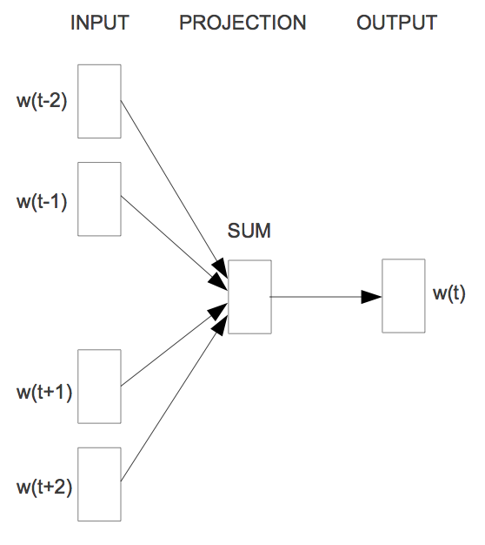
Word2vec - CBOW (Continuous Bag of words)
The way CBOW work is that it tends to predict the probability of a word given a context.
Let us start with an example (Tweet):
"When your dream becomes reality"
One approach is to treat ("When", "your", "becomes", "reality“) as a context and from these words, be able to predict or generate the center word "dream".
When
your
dream
becomes
reality
window size: 5
Source: https://www.analyticsvidhya.com/blog/2017/06/word-embeddings-count-word2veec/

Slide 14
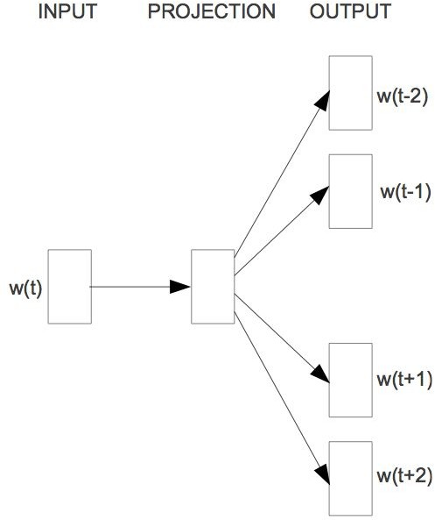
Word2vec - Skip-Gram Model
The aim of skip-gram is to predict the context given a word.
Let us check with same example (Tweet):
"When your dream becomes reality"
The approach is to create a model such that given the center word "dream", the model will be able to predict or generate the surrounding words ("When", "your", "becomes", "reality"). Here we call the word "dream" the context.
When
your
dream
becomes
reality
window size: 5
Source: https://www.analyticsvidhya.com/blog/2017/06/word-embeddings-count-word2veec/

Slide 15
Skip-Gram Model

Slide 16
Skip-Gram Model
Set up an objective function
Randomly initialize vectors
Do gradient descent

Slide 17
Skip-Gram Model
Learn word vector v_{in} from it’s surrounding context
"The fox jumped over the lazy dog”
Maximize the likelihood of seeing the words given the word over
P(the|over)
P(fox|over)
P(jumped|over)
P(the|over)
P(lazy|over)
P(dog|over)
…instead of maximizing the likelihood of co-occurrence counts

Slide 18
Skip-Gram Model
What should this be?
P(fox|over)
Should depend on the word vectors
P(fox|over)
P(vfox|vover)

Slide 19
Skip-Gram Model
A context window around every input word
P(v_{OUT}|v_{IN})
"The fox jumped over the lazy dog"
v_{OUT}
v_{IN}

Slide 20
Skip-Gram Model
A context window around every input word
P(v_{OUT}|v_{IN})
"The fox jumped over the lazy dog"
v_{OUT}
v_{IN}

Slide 21
Skip-Gram Model
A context window around every input word
P(v_{OUT}|v_{IN})
"The fox jumped over the lazy dog"
v_{OUT}
v_{IN}

Slide 22
Skip-Gram Model
A context window around every input word
P(v_{OUT}|v_{IN})
"The fox jumped over the lazy dog"
v_{IN}
v_{OUT}

Slide 23
Skip-Gram Model
A context window around every input word
P(v_{OUT}|v_{IN})
"The fox jumped over the lazy dog"
v_{IN}
v_{OUT}

Slide 24
Skip-Gram Model
A context window around every input word
P(v_{OUT}|v_{IN})
"The fox jumped over the lazy dog"
v_{IN}
v_{OUT}

Slide 25
Skip-Gram Model
A context window around every input word
P(v_{OUT}|v_{IN})
"The fox jumped over the lazy dog"
v_{OUT}
v_{IN}

Slide 26
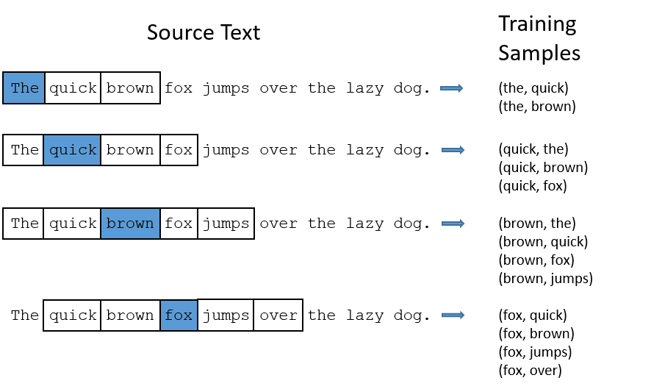
Skip-Gram Model

Slide 27
Skip-Gram Model
How should we define P(v_{OUT}|v_{IN})?
Measure loss between
v_{IN} and v_{OUT}
v_{IN} . v_{OUT}

Slide 28
v_{in} . v_{out} ~ 1
Skip-Gram Model
vin
vout

Slide 29
v_{in} . v_{out} ~ 0
Skip-Gram Model
vin
vout

Slide 30
v_{in} . v_{out} ~ -1
Skip-Gram Model
vin
vout

Slide 31
Skip-Gram Model
v_{in} . v_{out} ∈ [-1,1]
But we'd like to measure a probability
softmax(v_{in} . v_{out} ) ∈ [0,1]
Probability of choosing 1 of N discrete items
Mapping from vector space to a multinomial over words

Slide 32
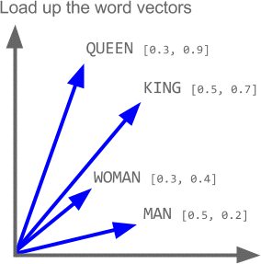

Slide 33
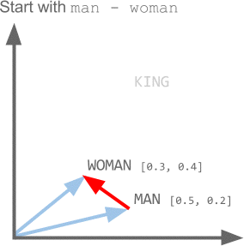

Slide 34
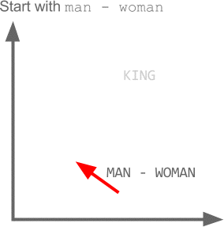

Slide 35
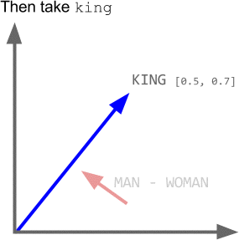

Slide 36
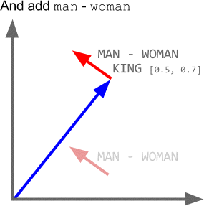

Slide 37
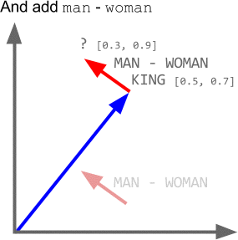

Slide 38
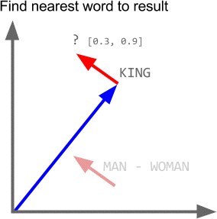

Slide 39
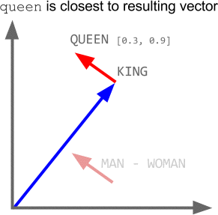

Slide 40
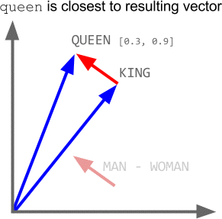

Slide 41
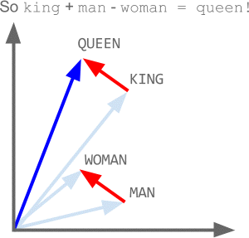

Slide 42
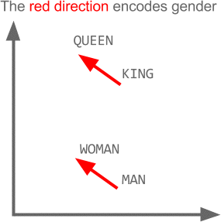

Slide 43
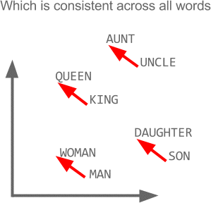

Slide 44
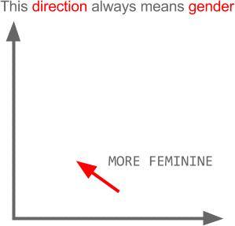

Slide 45
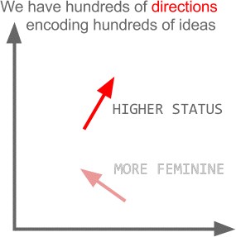

Slide 46



Dropout
Training:
Each time before updating the parameters
Each neuron has p% to dropout

Slide 47


Dropout
Training:
Thinner!
Each time before updating the parameters
Each neuron has p% to dropout
The structure of the network is changed.
Using the new network for training
For each mini-batch, we resample the dropout neurons

Slide 48




Dropout
Testing:
No dropout
If the dropout rate at training is p%, all the weights times (1-p)%
Assume that the dropout rate is 50%.
If a weight w = 1 by training, set 𝑤 = 0.5 for testing.

Slide 49






Dropout - Intuitive Reason
When teams up, if everyone expect the partner will do the work, nothing will be done finally.
However, if you know your partner will dropout, you will do better.
When testing, no one dropout actually, so obtaining
good results eventually.

Slide 50
Dropout - Intuitive Reason
Why the weights should multiply (1-p)% (dropout rate) when testing?
Training of Dropout
Assume dropout rate is 50%
Testing of Dropout
No dropout
Weights from training
𝑤₁
𝑤₂
𝑤₃
𝑤₄
0.5 ×
𝑤₁
𝑧′ ≈ 2𝑧
0.5 × 𝑤₂
_{𝑧}′
𝑧
0.5 × 𝑤₃
0.5 × 𝑤₄
Weights multiply (1-p)%
𝑧′ ≈ 𝑧

Slide 51
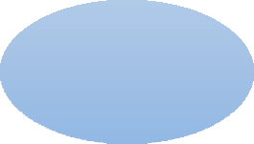





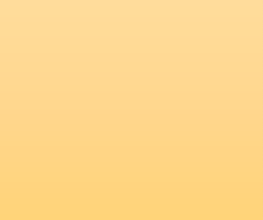
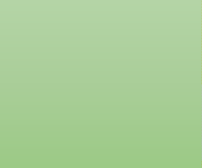
Dropout is a kind of ensemble.
Training
Ensemble
Set
Set 1
Set 2
Set 3
Set 4
Network 1
Network 2
Network 3
Network 4
Train a bunch of networks with different structures

Slide 52




Dropout is a kind of ensemble.
Ensemble
Testing data x
Network 1
Network 4
Network 2
Network 3
y₁
y₂
y₃
y₄
average

Slide 53
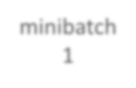
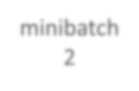
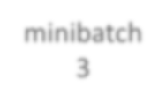
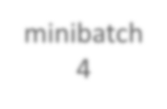





Dropout is a kind of ensemble.
minibatch
1
minibatch 2
minibatch
3
minibatch 4
Training of Dropout
M neurons
2^{M} possible networks
Using one mini-batch to train one network
Some parameters in the network are shared
……

Slide 54
Dropout is a kind of ensemble.
Testing of Dropout
testing data x
All the weights multiply (1-p)%
……
y₁
y₂
y₃
?????
≈
average
y

Slide 55

















Let’s try it
……
500
……
model.add( dropout(0.8) )
500
……
model.add( dropout(0.8) )
Softmax
y₁
y₂
^{y}10
……

Slide 56
Programming

Slide 57
callbacks
A callback is a set of functions to be applied at given stages of the training procedure
You can use callbacks to get a view on internal states and statistics of the model during training
keras.callbacks.Callback()

Slide 58
Tensorboard
Tensorflow, the deep learning framework from Google comes with a great tool to debug
It hosts a website on your local machine in which you can monitor things like accuracy, cost functions
and visualize the computational graph that Tensorflow is running based on what you defined in Keras
Pip install tensorboard

Slide 59
Tensorboard
tensorboard = TensorBoard(log_dir="logs/{}".format(time())) model.fit(x_train, y_train, verbose=1, callbacks=[tensorboard])
You need to create a new TensorBoard instance and point it to a log directory where data should be collected.
Next you need to modify the fit call so that it includes the tensorboard callback.
Then the following command in the separate terminal
tensorboard --logdir=logs/
http://localhost:6006/

Slide 60
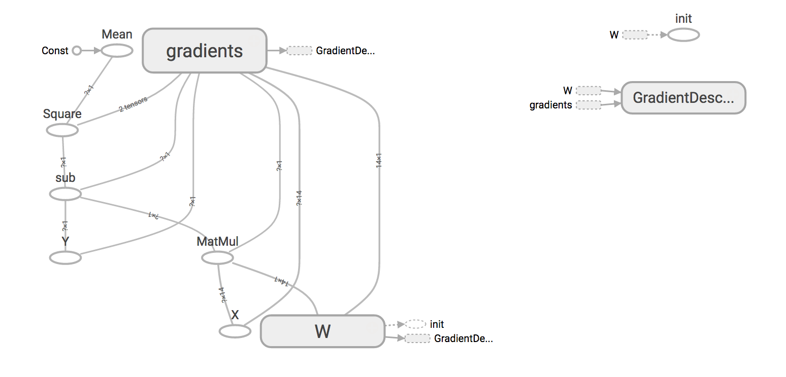
Tensorboard

Slide 61
References
https://deeplearning4j.org/word2vec.html
https://towardsdatascience.com/tagged/word2vec
https://medium.com/@Aj.Cheng/word2vec-3b2cc79d674
https://medium.com/tag/word2vec
https://www.analyticsvidhya.com/blog/2017/06/word-embeddings-count-word2veec/
http://mccormickml.com/2016/04/19/word2vec-tutorial-the-skip-gram-model/
https://becominghuman.ai/how-does-word2vecs-skip-gram-work-f92e0525def4

